Slide 1

Analyze stock market using Association rule
Group 12:
Duong Dinh Trung - 1814498
To Hoang Dao - 1852309

Slide 2
Content
Introduction
Methodology
Result
Reference

Slide 3
REVIEW
Association rule generation process is usually works in two phases:
Firstly, minimum support is applied to find all frequent itemsets and the minimum confidence constraint.
Second phase is most important to find rules based on these frequent itemsets and the minimum confidence constraint.

Slide 4
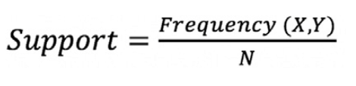
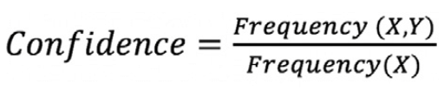
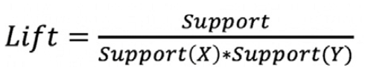
REVIEW
Support refers to the default popularity of an item.
Confidence refers to the likelihood that an item Y is also bought if item X is bought.
Lift(X->Y) refers to the increase in the ratio of sale of Y when X is sold.

Slide 5

01
Introduction
Stock investing is very risky business. To help investors reduce the risk, we introduce the stock analyzing using association rule method.

Slide 6

02
Methodology

Slide 7

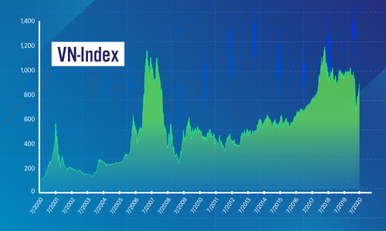
Data collection
We have 2 sources of data:
First was crawled from yahoo! finance (US stock).
Using ‘batdata library’ to crawl the second source (VN stock).
Period time: 12/10/2020-08/10/2021
Fig1. Source of Stock data

Slide 8
Data
Date | AMD |  | CHGG |  | NVDA
 | Open | Close | Open | Close | Open | Close
12/10/2020 | 83.29 | 84.65 | 82.419 | 81.23 | 139.895 | 142.259
13/10/2020 | 84.86 | 85.279 | 83.470 | 83.11 | 142.964 | 142.482
... | ... | ... | ... | ... | ... | ...
Fig2. Raw data from US stocks

Slide 9
Data
Date | FPT |  | MWG |  | PNJ |  | VNM
 | Open | Close | Open | Close | Open | Close | Open | Close
12/10/2020 | 43.34 | 43.34 | 71.44 | 70.46 | 62.915 | 61.526 | 102.74 | 102.93
13/10/2020 | 43.34 | 43.17 | 70.46 | 69.608 | 61.526 | 62.022 | 102.93 | 103.03
... | ... | ... | ... | ... | ... | ... | ... | ...
Fig3. Raw data from VN stocks

Slide 10
Data processing
Date | AMD | CHGG | NVDA
12/10/2020 | 0.639999 | 0.430000 | 2.364990
13/10/2020 | 0.419998 | 2.369995 | -0.482498
... | ... | ... | ...
Fig4. Changes between Open and Close in US stocks

Slide 11
Data processing
Date | FPT | MWG | PNJ | VNM
12/10/2020 | 0 | -0.98300 | -1.38999 | 0.19299
13/10/2020 | -0.17000 | -0.85199 | 0.49599 | 0.90960
... | ... | ... | ... | ...
Fig5. Changes between Open and Close in VN stocks

Slide 12
Naming rules
If change > 0: Type is 1
If change < 0: Type is 2
If change ==0: Type is 3
FPT: F
MWG: M
PNJ: P
VNM: V
AMD: S1
CHGG: S2
NVDA: S3

Slide 13
Data processing
Date | AMD | CHGG | NVDA
12/10/2020 | S11 | S21 | S31
13/10/2020 | S11 | S21 | S32
... | ... | ... | ...
Fig6. Convert label US stocks

Slide 14
Data processing
Date | FPT | MWG | PNJ | VNM
12/10/2020 | F3 | M2 | P2 | V1
13/10/2020 | F2 | M2 | P1 | V1
... | ... | ... | ... | ...
Fig7. Convert label VN stocks

Slide 15

03
Results

Slide 16
Rules from US stocks
01
02
03
{ S32}=>S12
{ S22, S11}=> S31
Confidence: 81.06%
=>If NVDA is down then AMD is down
Confidence: 83.33%
=>If CHGG is down and AMD is up then NVDA is up
{ S22 , S12}=> S32
Confidence: 85.37%
=>If CHGG is down and AMD is down then AMD is down

Slide 17
Rules from VN stocks
01
02
03
{ P1 , F1}=>M1
{ P1 , F1, V1}=>M1
Confidence: 81.69%
=>If PNJ is up and FPT is up and then MWG is up
Confidence: 91.17%
=>If PNJ is up and FPT is up and VNM is up then MWG is up
{ V2, M2, P2}=> F2
Confidence: 83.67%
=>If VNM is down and MWG is down and PNJ is down then FPT is down

Slide 18
04
Reference
Kamley, S., Jaloree, S., & Thakur, R. (1970, January 01). An Association Rule Mining Model for Finding the Interesting Patterns in Stock Market Dataset: Semantic Scholar. Retrieved June 08, 2020, from https://www.semanticscholar.org/paper/An-Association-Rule-Mining-Model-for-Finding-the-in-Kamley-Jal oree/35bd8d8c40a37e4e07c340f81cf494cd7d0d7d9d
Malik.. Association Rule Mining via Apriori Algorithm in Python. Stack Abuse. https://stackabuse.com/association-rule-mining-via-apriori-algorithm-in-python/?fbclid=IwAR3r5mqU_DSNhbj3wlCfKs-FAyftCYp5alkV2yhKd0ZHpQjSf5OxIw7js8k

Slide 19

Thank you!

